Slide 1
Topic 1 Basic Programming Concepts
ITP3914 – Programming

Slide 2

Part 1 – What is a computer?

Slide 3
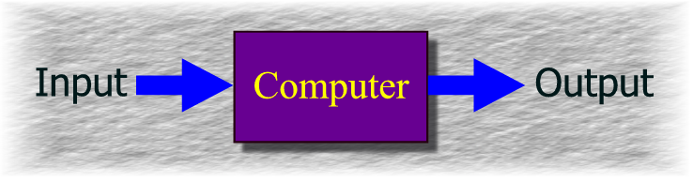
A computer accepts external input, processes the data, and produces certain output.
Performs computations and makes logical decisions.
Millions / billions / trillions times faster than human brains.

Slide 4
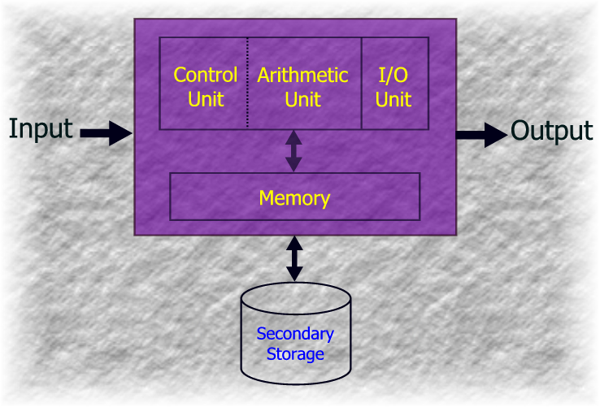
Key Elements in a Computer

Slide 5
Input Unit
Obtains information (data and programs) from various input devices, such as keyboard and disk drive.
Output Unit
Places processed information onto various output devices, such as screen or printer.
Memory Unit
Retains information entered from the input unit.
Stores programs.
Stores intermediate results during processing.
Arithmetic and Logic Unit (ALU)
Performs actual calculations and comparisons.
Control Unit
Supervises and coordinates the entire operations of a computer.
Secondary Storage
A device, such as tapes or disks, for storing programs or data that are not actively being used by other units.

Slide 6
Part 2 – A first taste on programming

Slide 7
What is a computer program?
Computer programs (software)
Sets of instructions for which computer processes data
E.g. Windows-8, MS Office 2013, Internet Explorer, Adobe Photoshop, and lots more…
A computer can’t do anything without software.
It is the software that makes computer intelligent!

Slide 8
Job of a Programmer
Software refers to a collection of instructions for the computer to follow and execute.
A computer only follows what the programmer tells it to do.
Therefore, the programmer has to know how to solve problems, and
The job of a programmer is to design a complete and precise set of instructions for a computer to carry out a particular problem-solving task.

Slide 9
Machine Language
At the lowest level (hardware), computers work with binary numbers (0s’ and 1s’).
So you may instruct the computer directly using 0 and 1. This is called Machine Language Programming
0110001111000010
0001000111100011
:
:
0011000100001000
1000001001010101
Machine
Language
Program
Very tedious and can make errors easily.
Machine dependent
(C) VTC, Prepared by sm-lau@vtc.edu.hk

Slide 10
Do you really want to program in machine language?
(C) VTC, Prepared by sm-lau@vtc.edu.hk

Slide 11
Assembly Language
Assembly Language – English-like abbreviations to represent computer operations. More human-readable.
Assembly Language
Machine Language
LD R0, #05
ADD R0, $1234
:
:
SUB R0, #22
LD $2345, R0
0110001111000010
0001000111100011
:
:
0011000100001000
1000001001010101
Assembler

Slide 12
An assembly language program is still too low-level and difficult to a human programmer!

Slide 13
Low-Level Languages
Since assembly and machine languages are oriented towards CPU, they are called low-level languages.
Assembly and machine languages are very difficult for human to read, write, and understand.
Assembly and machine languages are CPU dependent; a CPU cannot read programs written for other CPU architectures.

Slide 14
High-Level Languages
Solution
High level programming languages are provided to close the gap between human programmers and computers.
High Level Program
score = Homework + Quiz + Test;
if (score < 40)
retake();
else
print “Congratulations!”;

Slide 15
High-level Languages
Allow for writing more “English-like” instructions.
Contain commonly used mathematical operations.
By using a “translator”, high-level language programs can run on different CPUs.
The speed of “translated programs” will be slower than a low-level language programs.

Slide 16
High Level Language
score = Homework + Quiz + Test
If (score < 40)
retake();
Else
print “Congratulations!”
Assembly Language
LD R0, #05
ADD R0, $1234
SUB R0, #22
LD $2345, R0
Machine Language
0110001111000010
0001000111100011
0011000100001000
Easier and Easier! No more excuse saying that this module is difficult!

Slide 17
Example HLLs
C++, Java, C# are object-oriented programming languages; reusable software components that model real-world items.
Dinosaurs
Cobol – for business data processing; still in use in banks
Fortran – for scientific computation
Middle Aged
Pascal – a sophisticated but overly complicated HLL
C – a widely used HLL for general computing
Youngsters
C++ – an enhancement over C with object-oriented features
Java – an OO language with networking and lots other features
C# - developed by Microsoft in competition with Java
Java

Slide 18
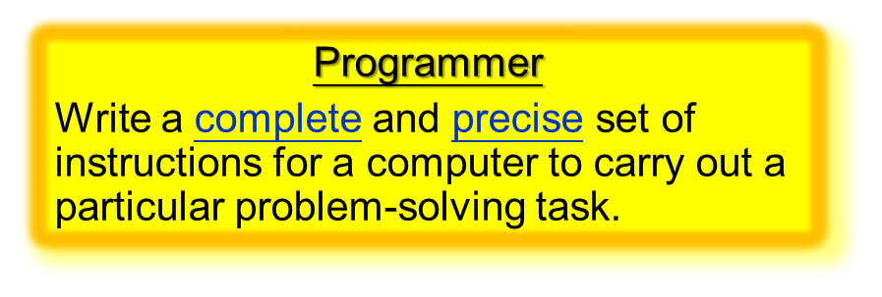
Your First Java Program
/*
* The HelloWorld Application
*/
public class HelloWorld {
public static void main(String [] argv)
{
System.out.println("Hello World!");
}
}

Slide 19
Part 3 – The Java program development process

Slide 20
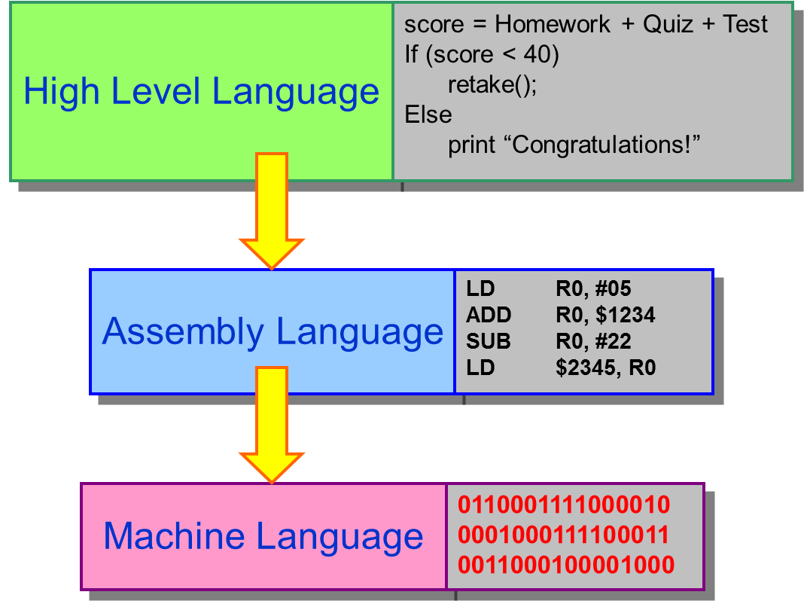
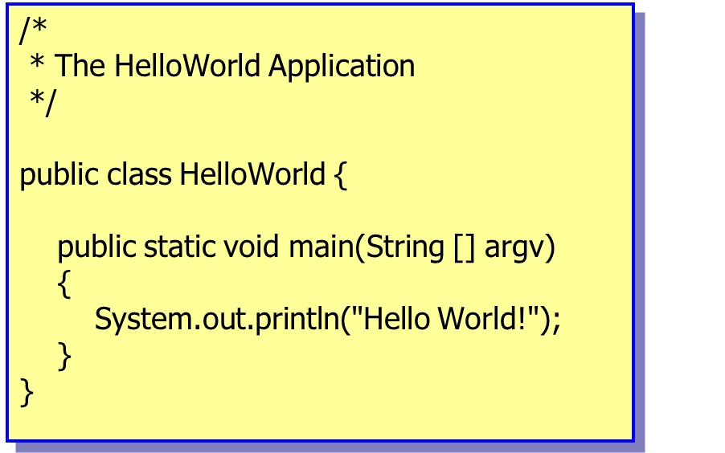
HLL and compilation
HLL programs are written as text files (source code).
Source codes have to be compiled before it can be executed.
A compiler is a piece of software that translates a high-level language program to a machine language program.

Slide 21
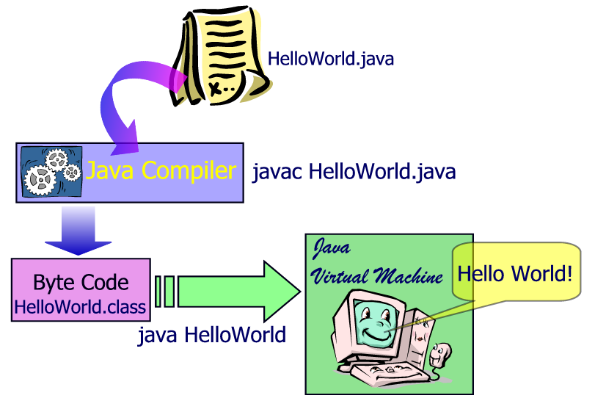
Java compilation process
Edit
Compile
Execute

Slide 22
Edit
c:\> textpad HelloWorld.java
c:\> javac HelloWorld.java
c:\> dir
1/09/2014 11:30 HelloWorld.java
1/09/2014 11:35 HelloWorld.class
c:\>
Compile
Execute
c:\> java HelloWorld
Hello World!

Slide 23
/*
* The HelloWorld Application
*/
public class HelloWorld {
public static void main(String [] argv)
{
System.out.println("Hello World!")
}
}
If you type anything incorrect, even missing a single letter or a punctuation, your program will fail to be compiled.
c:\> javac HelloWorld.java
HelloWorld.java:9: ‘;’ expected
System.out.println(“Hello World!”)
^
1 error
c:\> dir
1/09/2014 11:30 HelloWorld.java
c:\>

Slide 24
Edit
c:\> textpad HelloWorld.java
Compile
c:\> javac HelloWorld.java
Compilation Error
Execute
c:\> java HelloWorld
Hello World!
Execution Error

Slide 25
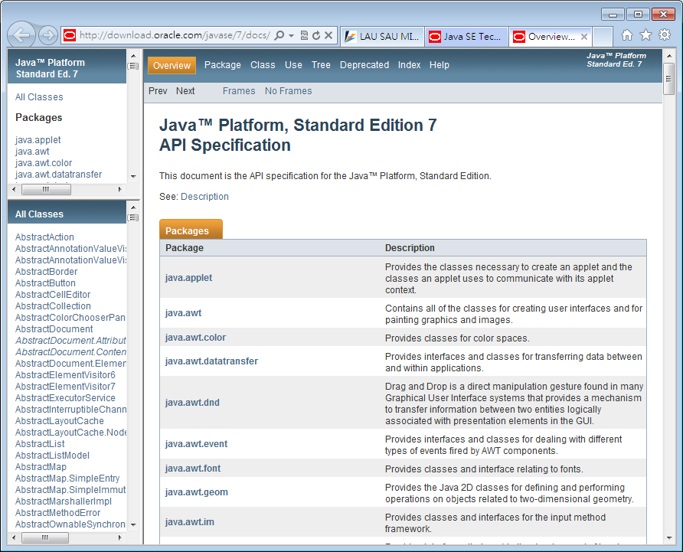

Java class library
Java already provides a huge library (more than 3000 ready-for-use classes in J2SE 7)
Collectively, known as Java APIs Application Programming Interfaces

Slide 26
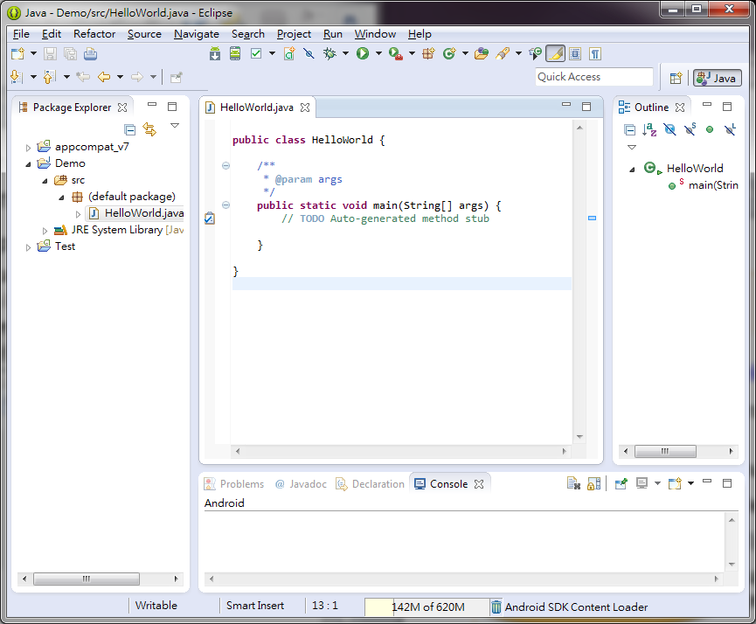

IDE for Java
IDE (Integrated Development Environment)
A tool that helps programmer to develop and debug his/her programs.
Netbeans (from Sun, thus Oracle)
Jdeveloper (from Oracle)
JBuilder (from Borland)
Eclipse (An IDE that supports many different programming languages, not just Java)
Eclipse

Slide 27
Part 4 – Some more details on Java programs

Slide 28
Java Program Structure
/*
* The HelloWorld Application
*/
public class HelloWorld {
public static void main(String [] argv)
{
System.out.println("Hello World!");
}
}
Multi-line Comment
Class header
Method main(). The core part of the program which defines what the program should do.
Don’t ask me what these are! Just copy!
This is the core statement in this simple program. It prints the string enclosed by “ “ on the screen.

Slide 29
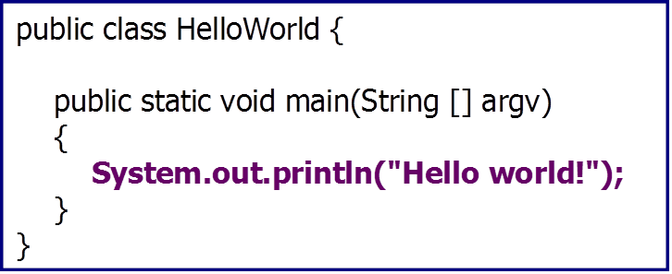
A Java program is made up of class definitions.
A class definition contains a header and a body.
The header defines the name of the class (and others).
public class HelloWorld
In this example, the body consists of main().
The filename must be same as the class name with .java appended, i.e. HelloWorld.java, in this example.

Slide 30
There are just too much details that you don’t have to understand at this moment.
But now we go through some more details in a Java program.

Slide 31
A More Complex Java Program
public class Circle {
public static void main(String [] args)
{
int radius;
double area;
radius = 3;
System.out.println("Radius = " + radius);
area = radius * radius * 3.14;
System.out.println("Area = " + area);
}
}
What is the purpose of this program?
Can you guess?
c:\> java Circle
Radius = 3
Area = 28.26
The program needs a place to store the area of the circle before it is printed.
VARIABLES!!!!!

Slide 32
Variables
Variables are storage spaces for your program to hold data values.
Variables are being stored in the computer memory.
Variables must be declared (created):
Type of data to be stored inside
Name of the variables

Slide 33
public class Circle {
public static void main(String [] args)
{
int radius;
double area;
radius = 3;
System.out.println("Radius = " + radius);
area = radius * radius * 3.14;
System.out.println("Area = " + area);
}
}
Data type
Name of the variable
radius
area
3
Assignment
radius
area
Expression
3
28.26
radius
area
You can also print the value stored in a variable.

Slide 34
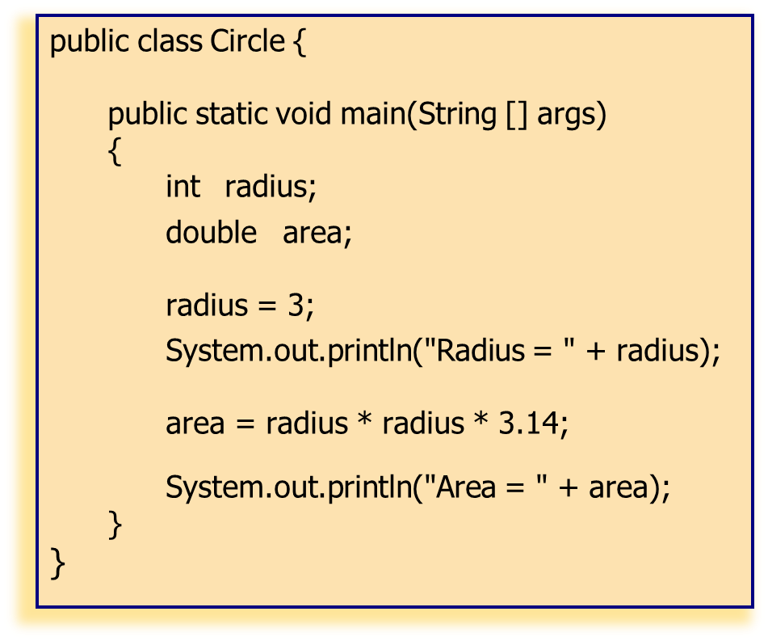
Does it work???
public class Circle {
public static void main(String [] args)
{
radius = 3;
int radius;
System.out.println("Radius = " + radius);
System.out.println("Area = " + area);
double area;
area = radius * radius * 3.14;
}
}
Strangely, students just put all the things into a program and HOPE they work correctly together.

Slide 35
Part 5 – Steps in program development

Slide 36
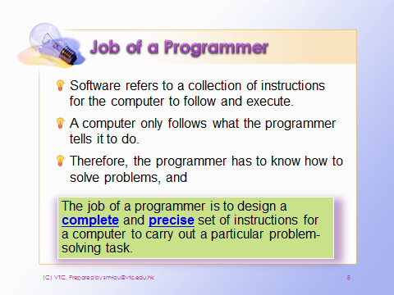
Recall that …

Slide 37
Steps in Program Development
Define the problem
Outline the solution
Turn the outline into steps for solving the problem
Test the steps for correctness
Code the steps into a targeted programming language
Run the program on a computer
Document and maintain the program

Slide 38
Based on the problem description, divide the problem into three separate components:
Input source data
Perform processing steps needed to produce the required outputs
Output results required
Processing

Slide 39
Basic operations
There are six basic operations in a solution:
Inputting the data
Outputting the result (and other intermediate messages)
Performing processing and calculation
Storing a data into variables
SELECTION – comparing two different values and selecting alternative actions
REPETITION – repeating a group of actions

Slide 40
How can the steps in a solution be expressed precisely and concisely?
Answer: Flowcharts
Graphically depict the logical steps to carry out a task and show how the steps relate to each other.

Slide 41
Flowchart Symbols
Flow line
Used to connect symbols
and indicate the flow of logic.
Terminal
Used to represent the beginning (Start) or
the end (End) of a task.
Input/Output
Used for input and output operations,
such as reading and displaying. The data to be read or displayed are described inside.
Used for arithmetic and data-manipulation
operations. The instructions are listed
inside the symbol.
Processing
Used for any logic or comparison operations.
Unlike the input/output and processing symbols,
which have one entry and one exit flowline, the decision symbol has one entry and two exit paths. The path chosen depends on whether the answer to a question is “yes” or “no”.
Decision

Slide 42
Connector
Used to join different flowlines.
Offpage Connector
Used to indicate that the flowchart continues to a second page.
Predefined Process
Used to represent a group of statements that perform one processing task.
Annotation
Used to provide additional information about another flowchart symbol.

Slide 43
The Structure Theorem
The Structure Theorem states that it is possible to write ANY computer program by using only the three basic control structures:
Sequence
Selection
Repetition

Slide 44
Series of steps – Sequence
Start
Process:
speed = distance / time
Input: distance
Input: distance
Input: time
Strangely, students like their programs to rush for calculation before data input.
Input: time
Process:
speed = distance / time
Output: speed
Output: speed
End

Slide 45
Example
Start
Input: number1
Problem: A program is required to get three numbers and then add them together and give their total.
Input: 3 numbers
Process: calculate the total of the 3 numbers
Output: total of the 3 numbers
Input: number2
Input: number3
Process:
total = number1 + number2 + number3
Output: total
End

Slide 46
Decision flow chart – Selection
Comparing two different values and selecting alternative actions
false
Is condition true?
true
Process step(s) 2
Process step(s) 1

Slide 47
Example
Start
Input:
Octopus balance
Problem: Determine if Octopus payment is accepted. If so, what the new balance is?
Input: Octopus balance, payment amount
Process: Check existing balance. Deduct payment amount from balance if it is sufficient.
Output: new balance or “insufficient Balance”
Input:
payment amount
amount
<= (balance+50)
false
true
Output:
“Insufficient Balance”
newBalance = balance - amount
Output:
newBalance
End

Slide 48
Looping flow chart – Repetition
Repeating a group of actions
Is condition true?
false
true
Process step(s)

Slide 49
Example
Start
set numStudent=0
set total=0
Problem: Calculate and report the average mark for a class of an examination.
Input: individual marks
Process: Sum individual marks to a total. Count the number of students. Calculate average as total/count.
Output: average mark
Loop
Input:
an individual mark
add mark to total
add 1 to numStudent
true
more student marks?
false
average = total / numStudent
Output: average
End

Slide 50
END

